Slide 1
Team 3
Preprocessing Data for Lung Disease
Team Members:
Prashant Ram
Muhammad Hassan
Mohamed Burhan
Gandhar Tare

Slide 2
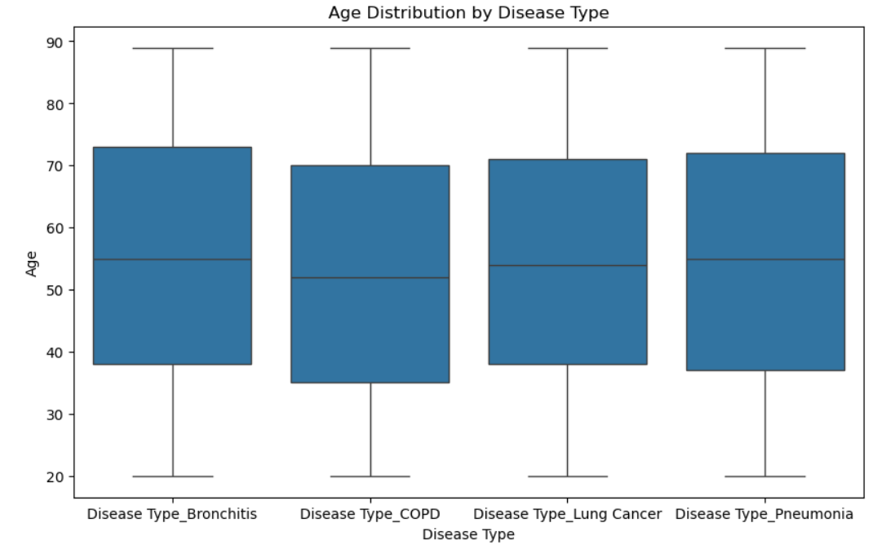
Age of Patients Against Their Disease Type
Interpretation
patients with bronchitis had 1/4 of them of ages between 20 - 38 and the other 1/4 between 74 - 89. The median age group suffering from this diseases were about 55.
For COPD, the first 1/4 were between 20 -35 and their upper 1/4 were between 70 - 89 while the median age was about 53.
For Lung cancer, the first 1/4 were between 20 -35 and their upper 1/4 were between 70 - 89 while the median age was about 54.For
Pneumonia, the first 1/4 were between 20 -38 and their upper 1/4 were between 72 - 89 while the median age was about 55.

Slide 3
Age of Patients Against Their Disease Type (cont.)
Human Insights
Based on the interpretation above, we can predict that people who suffer from lung diseases majority are in their mid 50's with the older age group(greater than 70) suffering from Bronchitis and Pneumonia.

Slide 4
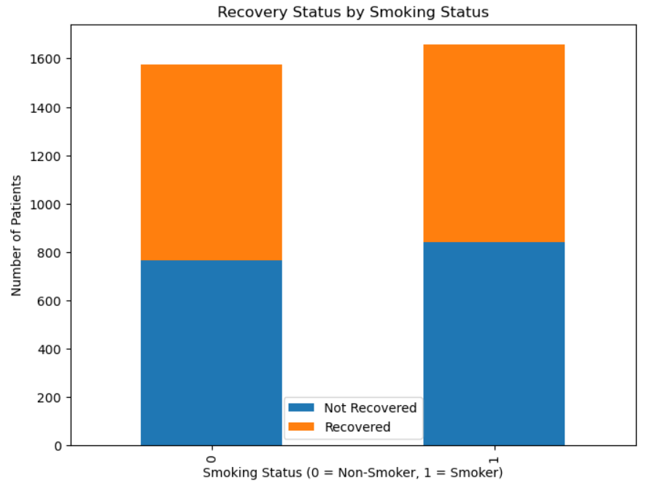
Recovery Status Against their Smoking Status
Interpretation
The stacked bar graph depicts that patients who were Non-smokers had about similar recovery outcomes as the ones who smoked. However, we can clearly see that Smokers had a higher outcome of not recovering from their lung diseases.
Insight
The insight that we can make from this is that smoking can worsen the recovery outcome of lung diseases.

Slide 5
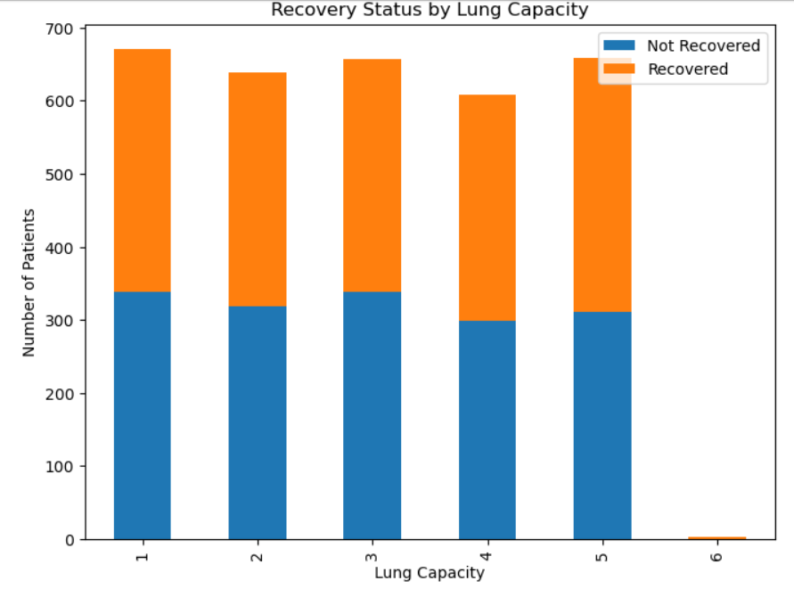
Recovery of Patient Against Their Lung Capacity
Interpretation
The stacked bar graph depicts that patients who had a lower lung capacity (1, 2 and 3) had higher "Not recovered" count. Moreover, patients with a high lung capacity (4-5) had about similar ratio of Recovered and Not Recovered. Finally, patients with the highest lung capacity of 6 had always recovered.
Insight
The insight that we can make from this is that a lower lung capacity can significantly reduce the recovery outcomes whereas a very high one can almost always guarantee recovery.

Slide 6
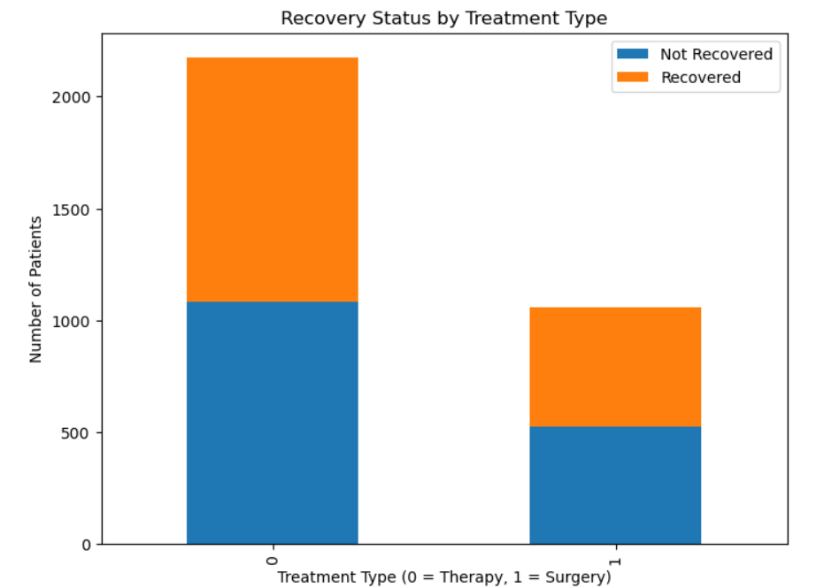
Recovery of Patient Against Their Lung Capacity
Interpretation
We can see that patients which opted for therapy as their form of treatment had a higher count of not recovering when compared to the ones who chose surgery. The ones who chose surgery had a higher count of recovering after the treatment.
Insight
We can say that surgical forms of treatment work much better than just therapeutical kind.

Slide 7
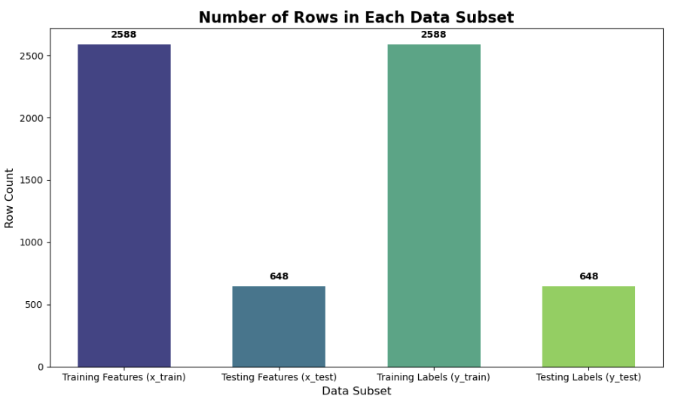
Data Subset Overview & Target Distribution
What It Shows:
This bar chart presents the number of samples in each data subset from our 80/20 train/test split.
It includes “Training Features (x_train)”, “Testing Features (x_test)”, “Training Labels (y_train)”, and “Testing Labels (y_test)”.
Interpretation:
The chart confirms that approximately 80% of the samples are in the training set and 20% in the testing set. The exact counts, annotated on each bar, ensure we have a clear, balanced split.
Machine Analysis Insight:
Automated splitting methods were used to ensure that our data distribution remains consistent, which is crucial for building reliable predictive models.

Slide 8
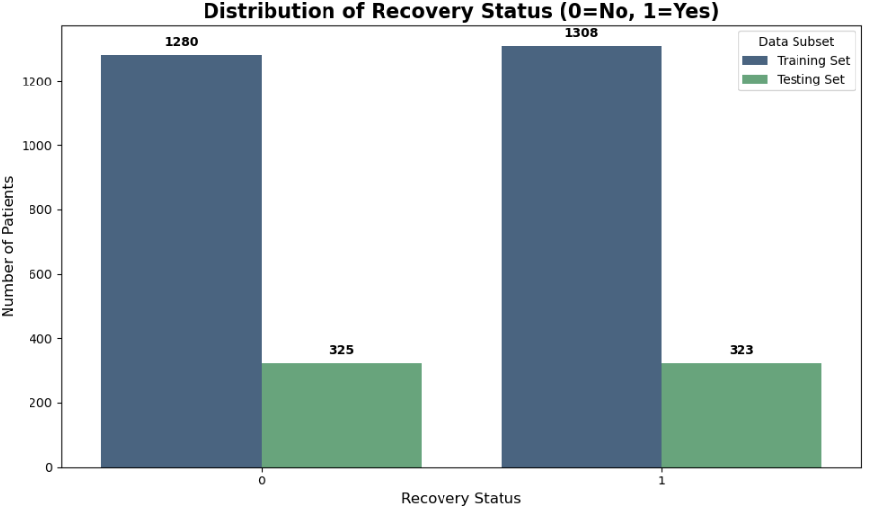
Distribution of Recovery Status
What It Shows:
This count plot compares the number of recovered versus non-recovered patients across the training and testing sets.
Interpretation:
It verifies that the target variable distribution is maintained between the two subsets, preventing bias.
Machine Analysis Insight:
Preserving the inherent class balance through machine-driven preprocessing supports robust and unbiased model training.

